Slide 1
Kubernetes Security
Chen Fei
Suneel Gandham
Ebhadulla Shaik

Slide 2
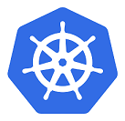
What is K8S?
K8S - Kubernetes
Open source container orchestration tool
Developed by Google by name Brog.
Helps you manage containerized applications in different application environments

Slide 3

The need for a container orchestration tool
Trend from Monolith to Microservices
Increased usages of containers
Need for managing hundreds of independent microservices
Managing them self made tools is difficult
Availability
Scalability
Disaster recovery

Slide 4
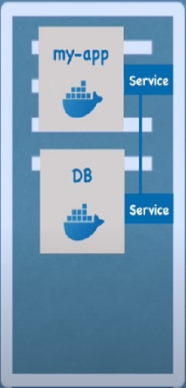
Kubernetes Basics
POD:
Abstraction over container and
Smallest unit of K8S
Container

Slide 5
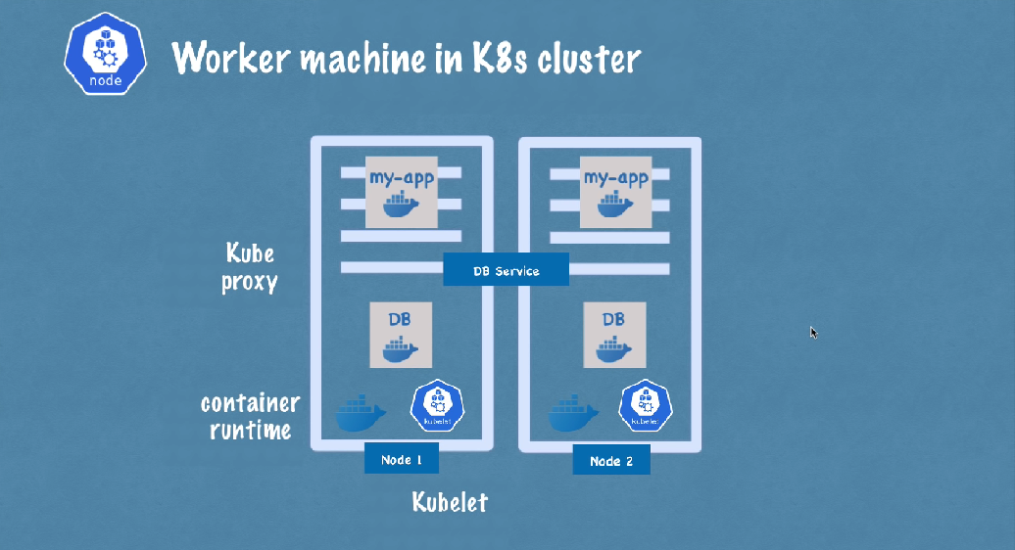
Kubernetes Architecture

Slide 6
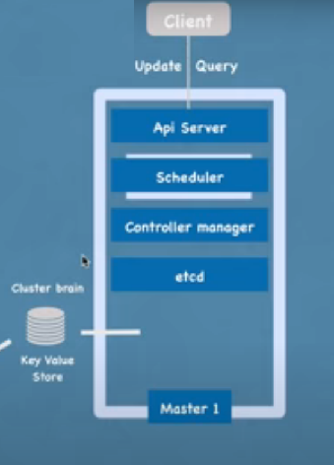
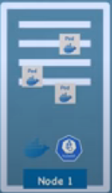
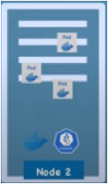
Kubernetes Architecture
30% used
60% used

Slide 7
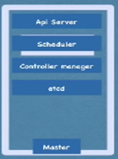
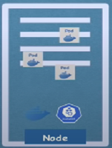
Scale as needed

Slide 8
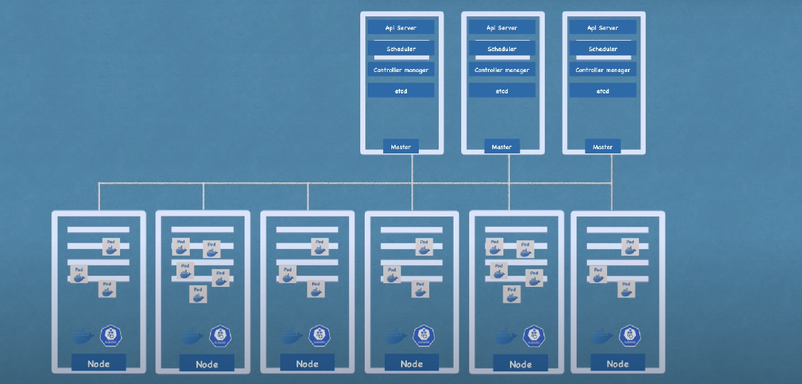
Cluster view

Slide 9
Few Key components
Services
Ingress
ConfigMap
Secrets
Kube Proxy
Kubelet
Deployment
Volumes

Slide 10
How Secure Kubernetes by default?
Misconception: Cloud is always secure.
It is just that, on cloud different security tools are available which we can leverage.
K8s main aim is container orchestration and not much focus on security.
Don’t worry… we have tools to secure the infrastructure.

Slide 11



Building a secure image in CI/CD pipeline
Causes for insecure image:
Code from untrusted registries
Vulnerabilities in tools of OS or code libraries
Best Practices:
Scanning the images in CI/CD pipeline using tools before pushing to registry.
Scan images regularly that are pushed to registry.

Slide 12

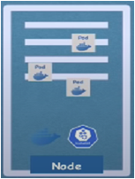

Secure Container and Pods
Running a container with root user will make attacker’s job easy to escalate the privileges.
Attacker can easily break out from the container and can access the underlying host.

Slide 13
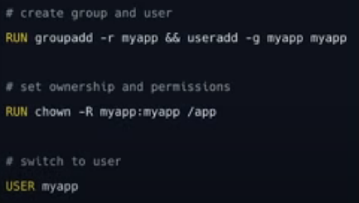
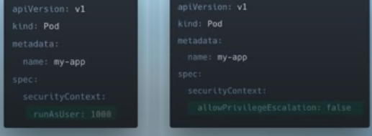
Best Practice: Run container as non-root
Create service user and run the container with that user
Don’t allow privilege escalation

Slide 14
Secure Container and Pods
Avoid running privileged Pods
Set limits on cluster resources for containers
Resource quota
Limit ranges for the resources

Slide 15
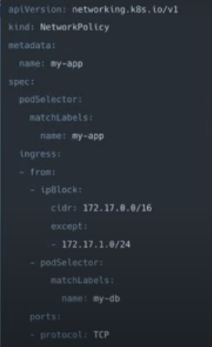



Securing communication between Pods
Control how the Pods communicate with each other using,
NetworkPolicy
Firewalls for pods.
Calico

Slide 16
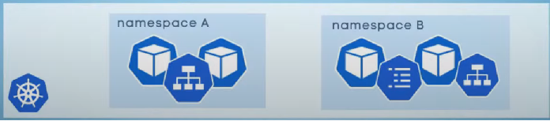
Maintaining Namespaces
Namespaces help in separating the resources, there by limiting the scope in case of attacks.

Slide 17
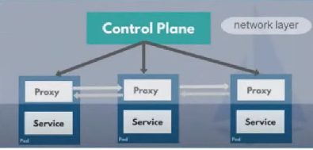
Securing communication between Pods
Service Mesh
mTLS – Mutual TLS
Limits the communication with Network Rules
Abstracts the rules to a layer of infrastructure and out of individual services

Slide 18
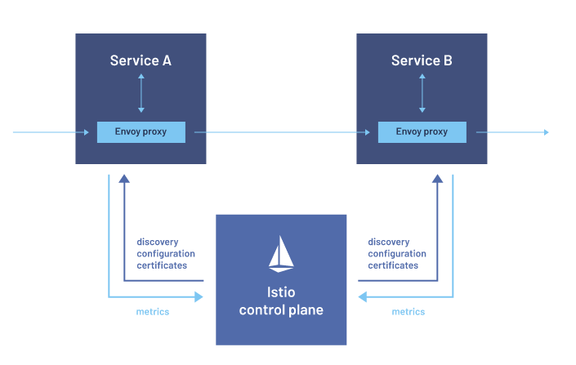
Service Mesh Implementations
Istio (native implementation) – Kiali dashboard
Linkered
Consul Connect(HashiCorp)

Slide 19


Securing etcd & secrets data
By default secrets and configurations are stored as plain text
Encoding them is not sufficient.
Tools:
HashiCorp’s Vault
Encryption tools from cloud providers
Safe backup and recovery with K8s native K10.

Slide 20



Securing access to K8s cluster
Don’t allow access application by node port.
LoadBalancer is better
Ingress is even better

Slide 21


Securing access to K8s cluster
Authentication
Certificates for authenticating users
Client certificates for human users
Service Accounts for non-human users

Slide 22
Securing access to K8s cluster
Authorization
Role Based Access Control (RBAC)
Cluster-wide
Cluster Role
Cluster Role Binding
Namespace-scoped
Role
Role Binding
Give least possible privileges for an user

Slide 23
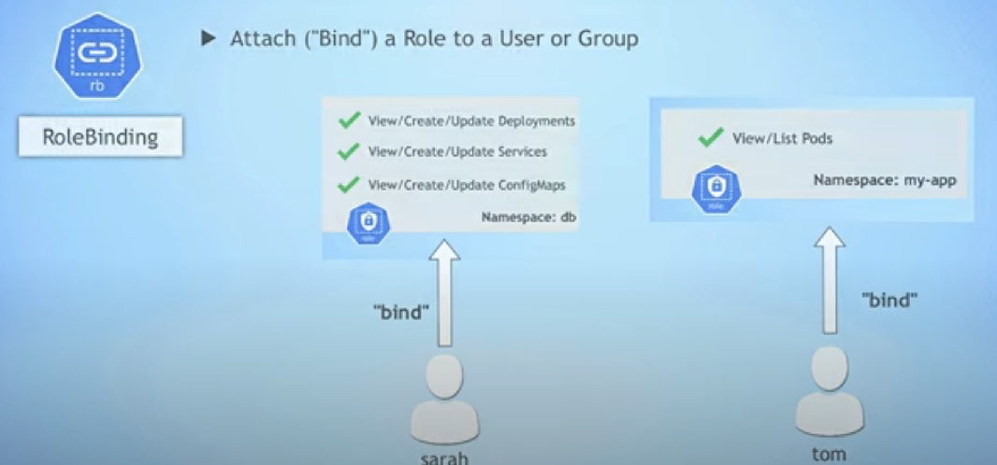
Role Based Access Control

Slide 24
Monitor and Mitigate Runtime Attacks
Monitoring communications of Pods
Using monitoring and logging tools
Kiali
Prometheus
Fluent Bit
Grafana

Slide 25
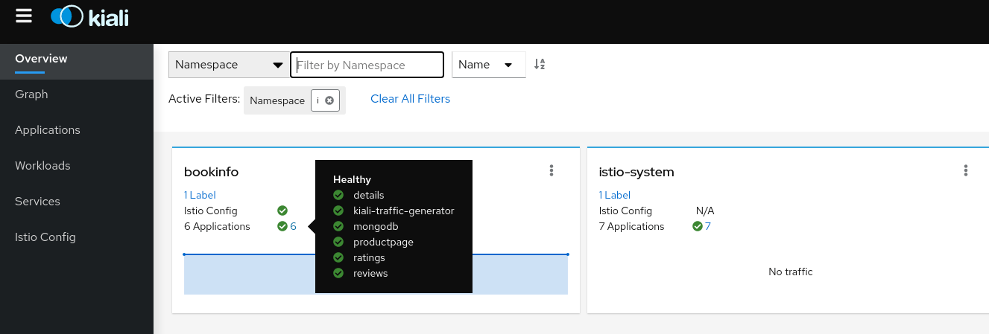
Kiali dashboard

Slide 26
Thank you

